Slide 1
Module 2
Two-Dimensional and Three-Dimensional Shapes

Slide 2
Thank you so much for your purchase!
Be sure to view each lesson in Slide Show. Some slides contain text boxes or objects that appear with a click of the mouse. These slides may look jumbled in design mode.

Slide 3
Lesson Links Click on the lesson you want to go to!
Lesson 1 Lesson 6
Lesson 2 Lesson 7
Lesson 3 Lesson 8
Lesson 4 Lesson 9
Lesson 5 Lesson 10
PRINTABLES

Slide 4
Colorful shape template for Lesson 1 Mystery Bags.
Template

Slide 5
Lesson 1
I can find and describe shapes.

Slide 6
Module 2, Lesson 1
Fluency
Making 5 with 5-Group Mats
Touch and count your cubes. Touch and count the dots on your mat. Our job is to make 5. Put 4 cubes on the dots of your mat. Raise your hand when know how many more cubes to make 5.

Slide 7
Module 2, Lesson 1
Fluency
Making 5 with 5-Group Mats
We can tell how to make 5 like this: 4 and 1 make 5.
Echo me, please.

Slide 8
Module 2, Lesson 1
Fluency
Making 5 with 5-Group Mats
Put 3 cubes on the dots of your mat. Raise your hand when know how many more cubes to make 5. Tell me the number sentence.

Slide 9
Module 2, Lesson 1
Fluency
Making 5 with 5-Group Mats
Put 2 cubes on the dots of your mat. Raise your hand when know how many more cubes to make 5. Tell me the number sentence.

Slide 10
Module 2, Lesson 1
Fluency
Making 5 with 5-Group Mats
Put 1 cube on the dots of your mat. Raise your hand when know how many more cubes to make 5. Tell me the number sentence.

Slide 11
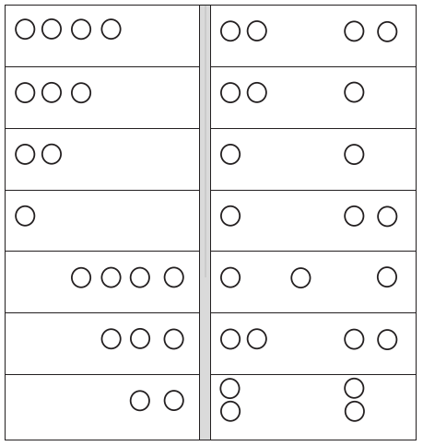
Module 2, Lesson 1
Fluency
Draw More to Make 5
Let’s do a few together. Then, I want you to do as many
problems as you can before time is up.

Slide 12
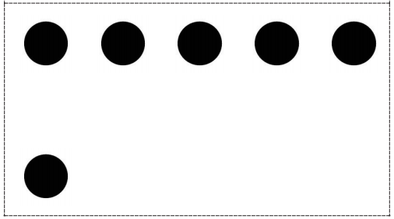
Module 2, Lesson 1
Fluency
5-Group Hands
Raise your hand when you know how many dots are on top. Bottom?

Slide 13
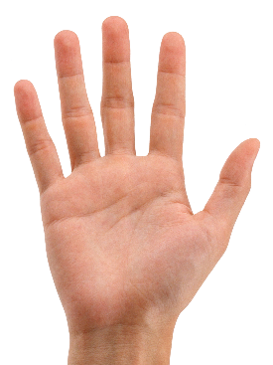
Module 2, Lesson 1
Fluency
5-Group Hands
We can show this 5-group on our hands. Five on top, 1 on the bottom, like this.

Slide 14
Module 2, Lesson 1
Fluency
5-Group Hands
Push your hands out as you count on from 5, like this. (Click) Try it with me!
Five…
Six

Slide 15
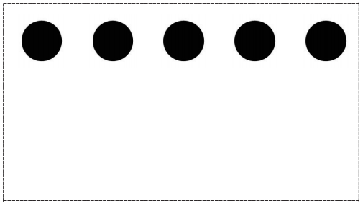
Module 2, Lesson 1
Fluency
5-Group Hands
Raise your hand when you know how many dots are on top. Bottom? Show this 5-group with your hands and then count on.

Slide 16
Module 2, Lesson 1
Fluency
5-Group Hands
Raise your hand when you know how many dots are on top. Bottom? Show this 5-group with your hands and then count on.

Slide 17
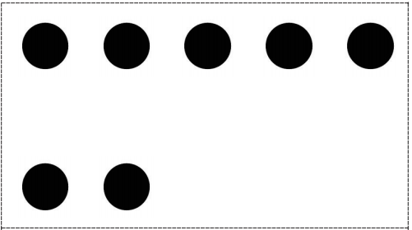
Module 2, Lesson 1
Fluency
5-Group Hands
Raise your hand when you know how many dots are on top. Bottom? Show this 5-group with your hands and then count on.

Slide 18
MATH LESSON
2D Shapes I Know- (song for kids) - YouTube
I can sort shapes by curvy or straight features.

Slide 19
Module 2, Lesson 1
You have a mystery bag! Open your bag, and carefully shake out the surprises inside. What do you see?

Slide 20
Module 2, Lesson 1
Look at my shape. Can you find the one that looks like mine? Tell me about the shape.

Slide 21
Module 2, Lesson 1
Look at my shape. Can you find the one that looks like mine? Tell me about the shape.

Slide 22
Module 2, Lesson 1
Look at my shape. Can you find the one that looks like mine? Tell me about the shape.

Slide 23
Module 2, Lesson 1
Look at my shape. Can you find the one that looks like mine? Tell me about the shape.

Slide 24
Module 2, Lesson 1
Look at my shape. Can you find the one that looks like mine? Tell me about the shape.

Slide 25
Module 2, Lesson 1
Look at my shape. Can you find the one that looks like mine? Tell me about the shape.

Slide 26
Module 2, Lesson 1
Look at my shape. Can you find the one that looks like mine? Tell me about the shape.

Slide 27
Module 2, Lesson 1
Look at my shape. Can you find the one that looks like mine? Tell me about the shape.

Slide 28
Module 2, Lesson 1
Look at my shape. Can you find the one that looks like mine? Tell me about the shape.

Slide 29
Module 2, Lesson 1
Look at my shape. Can you find the one that looks like mine? Tell me about the shape.

Slide 30
Module 2, Lesson 1
Look at my shape. Can you find the one that looks like mine? Tell me about the shape.

Slide 31
Module 2, Lesson 1
Look at my shape. Can you find the one that looks like mine? Tell me about the shape.

Slide 32
Module 2, Lesson 1
Look at my shape. Can you find the one that looks like mine? Tell me about the shape.

Slide 33
Module 2, Lesson 1
Arrange your shapes on your desktop. Do they have anything in common? Now, bend down so that you are looking across the edge of your desktop. Can you see your shapes now? Are any of them sticking up?
These are all flat shapes!

Slide 34
Module 2, Lesson 1
Put your shapes back in the bag. It’s time to play shape detectives! Detectives need to have special equipment, so I’m going to give you and your partner a magnifying glass to use if you need it. You are going to go on a shape hunt around the room. Whenever you see an interesting shape, tell your partner about it, and draw it on your paper. Take your bag of shapes with you to use as clues. Maybe you will find shapes in the room that match shapes in your bag!

Slide 35
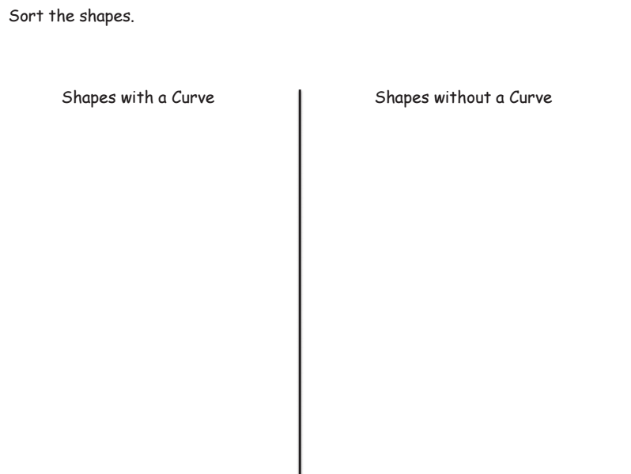
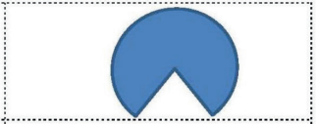
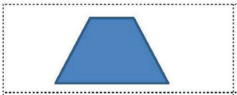
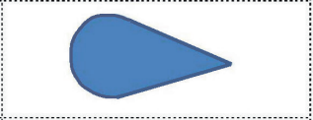
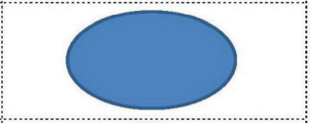
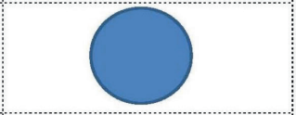
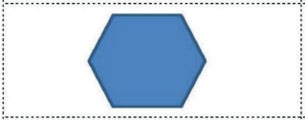
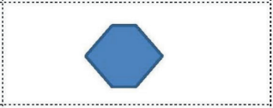
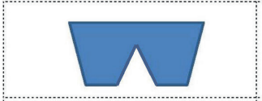
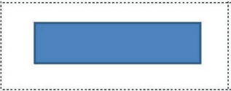
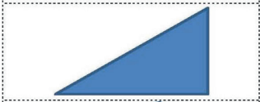
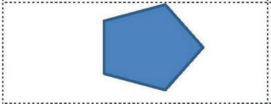
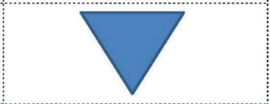

Slide 36
Debrief

Slide 37
Lesson 2
I can identify shapes as triangles.

Slide 38
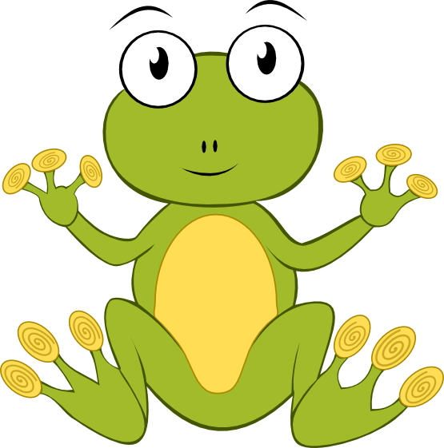
Module 2, Lesson 2
Fluency
Making 3 With Triangles and Beans
Touch and count the corners of the triangle. Touch and count your beans.

Slide 39
Module 2, Lesson 2
Fluency
Making 3 With Triangles and Beans
Our job is to make 3. Put 2 of your beans on the corner of your triangle. Keep the other one in your hand. How many beans are on your triangle?

Slide 40
Module 2, Lesson 2
Fluency
Making 3 With Triangles and Beans
We can tell how to make 3 like this: 2 and 1 make 3. Echo me, please. Write the equation on your white board. Show me 1 bean on your triangle. Keep the rest in your hand.

Slide 41
Module 2, Lesson 2
Fluency
Making 3 With Triangles and Beans
How many beans are on your triangle? How many beans in your hand? Raise your hand when you can say the sentence. Start with 1. Write the equation on your white board.

Slide 42
Module 2, Lesson 2
Fluency
Making 3 With Triangles and Beans
Show me 3 beans on your triangle.

Slide 43
Module 2, Lesson 2
Fluency
Making 3 With Triangles and Beans
How many beans are on your triangle? How many beans in your hand? Raise your hand when you can say the sentence. Start with 3. Write the equation on your white board.

Slide 44
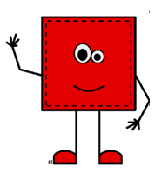
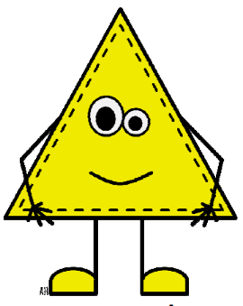
Module 2, Lesson 2
Fluency
Make a Shape
Let’s play Make a Shape. Put 3 of the longer craft sticks on your mat. Move the sticks so they make a shape with 3 points. Touch and count the points. Touch and count the sides. Are there any curved sides?

Slide 45
Module 2, Lesson 2
Fluency
Make a Shape
Trade in your three long sticks for three short ones, and put them on your mat. Move the sticks so they make a new shape with three points. Does your shape still have three points? Three sides? No curved sides?

Slide 46
Module 2, Lesson 2
Fluency
Make a Shape
Now, put one of your sticks back and get one of the longer ones to put on your mat. Move the sticks so they make a new shape with three points. Does your shape still have three points? Three sides? No curved sides?

Slide 47
Module 2, Lesson 2
Fluency
Make a Shape
Now, take two long sticks and one short stick. Make a shape with three points. Does the shape still have three points? Three sides? No curved sides?

Slide 48
Module 2, Lesson 2
Fluency
Make a Shape
Now, take four long sticks. Make a shape with four points. Touch and count the points. Touch and count the sides. Are there any curved sides?

Slide 49
Module 2, Lesson 2
Fluency
Make a Shape
Now, take four short sticks. Make a shape with four points. Does your shape still have four points? Four sides? No curved sides?

Slide 50
Module 2, Lesson 2
Fluency
Make a Shape
Now, take two long sticks and two short sticks. Make a shape with four points. Does your shape still have four points? Four sides? No curved sides?

Slide 51
Module 2, Lesson 2
Fluency
Groups of 6
When the music starts, calmly walk around the room, visiting corners of the room until you and your classmates can make a group of 6 – don’t forget to count yourself! How many can be in a group? So if you go to a corner that already has 5 people there, can you stay? What if there are already 6? Remember to check all corners of the room. See if we can all get into groups of 6 before the music stops!

Slide 52
Application Problem
Module 2, Lesson 2
It’s pizza time! On a piece of paper, draw a large, round pizza pie. Don’t forget your favorite toppings! With your crayons, show how you would cut the pizza into enough slices for your family. Compare your slices to those of a partner. Are they alike? Carefully describe the shape of a slice to your partner.

Slide 53
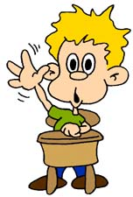
Module 2, Lesson 2
What were some of the things you noticed about your shapes in our last lesson?

Slide 54
Module 2, Lesson 2
We’re going to look at some more shapes today to see what else you notice. Ready?

Slide 55
Module 2, Lesson 2
We call a shape like this a triangle.
triangle

Slide 56
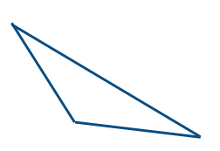
Module 2, Lesson 2
Tell me about this shape.
triangle

Slide 57
Module 2, Lesson 2
I’m beginning to see a pattern! How many corners does each shape have? How many sides? What do the sides look like?
triangle
A triangle has 3 straight sides and 3 corners!

Slide 58
Module 2, Lesson 2
If you were to put a pet inside this fence, it could escape! So, triangles have to be closed!
Here is another shape. It has three corners, and all the sides are straight. It must be a triangle!
triangle
NOT a triangle
triangle

Slide 59
Module 2, Lesson 2
Here is another shape.
Is it a triangle?
triangle
triangle
triangle

Slide 60
Module 2, Lesson 2
Here is another shape.
Is it a triangle?
triangle
triangle
triangle

Slide 61
Module 2, Lesson 2
Here is another shape.
Is it a triangle?
NOT a triangle
triangle
triangle

Slide 62
Module 2, Lesson 2
We have several triangles on the board. Copy these triangles onto your geoboard. Remember, you can only use one rubber band. Stretch it around three corners!
triangle

Slide 63
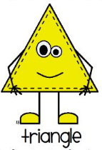
Module 2, Lesson 2
Now, create your own triangle on your geoboard, and then show your partner. Be sure to tell how you know it’s a triangle!

Slide 64
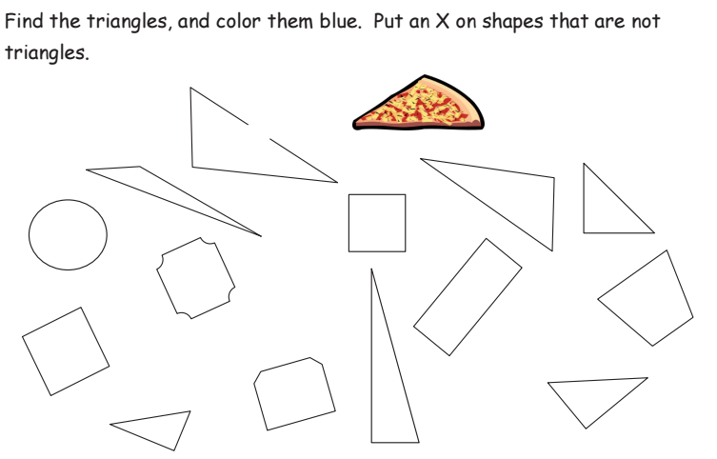

Slide 66
Debrief

Slide 67
Lesson 3
I can identify shapes as rectangles.

Slide 68
Module 2, Lesson 3
Fluency
5-Group Hands
Raise your hand when you know how many dots are on top. Bottom?

Slide 69
Module 2, Lesson 3
Fluency
5-Group Hands
We can show this 5-group on our hands. Five on top, 1 on the bottom, like this.

Slide 70
Module 2, Lesson 3
Fluency
5-Group Hands
Push your hands out as you count on from 5, like this. (Click) Try it with me!
Five…
Six

Slide 71
Module 2, Lesson 3
Fluency
5-Group Hands
Raise your hand when you know how many dots are on top. Bottom? Show this 5-group with your hands and then count on.

Slide 72
Module 2, Lesson 3
Fluency
5-Group Hands
Raise your hand when you know how many dots are on top. Bottom? Show this 5-group with your hands and then count on.

Slide 73
Module 2, Lesson 3
Fluency
5-Group Hands
Raise your hand when you know how many dots are on top. Bottom? Show this 5-group with your hands and then count on.

Slide 74
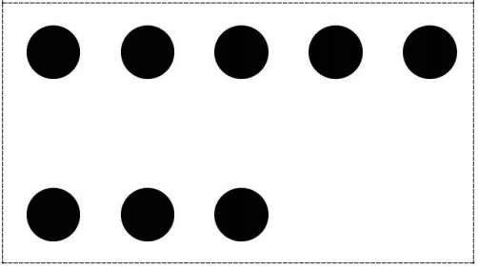
Module 2, Lesson 3
Fluency
5-Group Hands
Raise your hand when you know how many dots are on top. Bottom? Show this 5-group with your hands and then count on.

Slide 75
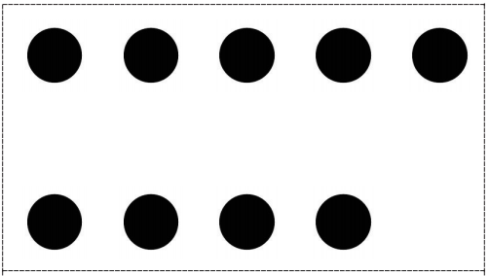
Module 2, Lesson 3
Fluency
5-Group Hands
Raise your hand when you know how many dots are on top. Bottom? Show this 5-group with your hands and then count on.

Slide 76
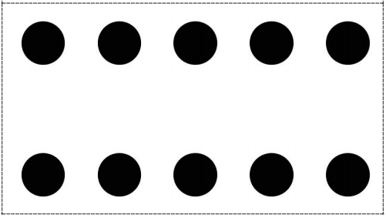
Module 2, Lesson 3
Fluency
5-Group Hands
Raise your hand when you know how many dots are on top. Bottom? Show this 5-group with your hands and then count on.

Slide 77
Module 2, Lesson 3
Fluency
Making 4 With Squares and Beans
Touch and count the corners of the square. Touch and count your beans. Our job is to make 4. Put 3 of your beans on the corners of your square. Keep the other one in your hand. How many beans are on your square?

Slide 78
Module 2, Lesson 3
Fluency
Making 4 With Squares and Beans
We can tell how to make 4 like this: 3 and 1 make 4. Echo me, please.
Write the equation on your white board.

Slide 79
Module 2, Lesson 3
Fluency
Making 4 With Squares and Beans
Show me 2 beans on your square. Keep the rest in your hand. How many beans are on your square? How many beans in your hand? Raise your hand when you can say the sentence. Write it on your board.

Slide 80
Module 2, Lesson 3
Fluency
Making 4 With Squares and Beans
Show me 1 bean on your square. Keep the rest in your hand. How many beans are on your square? How many beans in your hand? Raise your hand when you can say the sentence. Write it on your board.

Slide 81
Module 2, Lesson 3
Fluency
Making 4 With Squares and Beans
Show me 4 beans on your square. Keep the rest in your hand. How many beans are on your square? How many beans in your hand? Raise your hand when you can say the sentence. Write it on your board.

Slide 82
Module 2, Lesson 3
Fluency
Making 4 With Squares and Beans
Show me 0 beans on your square. Keep the rest in your hand. How many beans are on your square? How many beans in your hand? Raise your hand when you can say the sentence. Write it on your board.

Slide 83
Module 2, Lesson 3
Fluency
Triangle or Not?
I’ll show you a shape. We’ll try to decide if it’s a triangle or not. If you think it’s a triangle, give me a thumbs-up. If it’s not a triangle, thumbs-down. Either way, be ready to explain your choice. Here we go!

Slide 84
Module 2, Lesson 3
Fluency
Triangle or Not?
I’ll show you a shape. We’ll try to decide if it’s a triangle or not. If you think it’s a triangle, give me a thumbs-up. If it’s not a triangle, thumbs-down. Either way, be ready to explain your choice. Here we go!

Slide 85
Module 2, Lesson 3
Fluency
Triangle or Not?
I’ll show you a shape. We’ll try to decide if it’s a triangle or not. If you think it’s a triangle, give me a thumbs-up. If it’s not a triangle, thumbs-down. Either way, be ready to explain your choice. Here we go!

Slide 86
Module 2, Lesson 3
Fluency
Triangle or Not?
I’ll show you a shape. We’ll try to decide if it’s a triangle or not. If you think it’s a triangle, give me a thumbs-up. If it’s not a triangle, thumbs-down. Either way, be ready to explain your choice. Here we go!

Slide 87
Module 2, Lesson 3
Fluency
Triangle or Not?
I’ll show you a shape. We’ll try to decide if it’s a triangle or not. If you think it’s a triangle, give me a thumbs-up. If it’s not a triangle, thumbs-down. Either way, be ready to explain your choice. Here we go!

Slide 88
Module 2, Lesson 3
Fluency
Triangle or Not?
I’ll show you a shape. We’ll try to decide if it’s a triangle or not. If you think it’s a triangle, give me a thumbs-up. If it’s not a triangle, thumbs-down. Either way, be ready to explain your choice. Here we go!

Slide 89
Module 2, Lesson 3
Fluency
Triangle or Not?
I’ll show you a shape. We’ll try to decide if it’s a triangle or not. If you think it’s a triangle, give me a thumbs-up. If it’s not a triangle, thumbs-down. Either way, be ready to explain your choice. Here we go!

Slide 90
Module 2, Lesson 3
Fluency
Triangle or Not?
I’ll show you a shape. We’ll try to decide if it’s a triangle or not. If you think it’s a triangle, give me a thumbs-up. If it’s not a triangle, thumbs-down. Either way, be ready to explain your choice. Here we go!

Slide 91
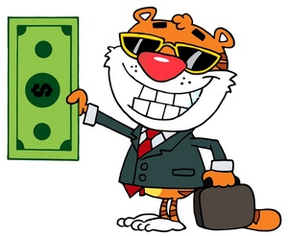
Application Problem
Module 2, Lesson 3
Design your own dollar bill! Draw your dollar bill on a piece of paper. Whose picture will you put in the center? Compare your dollar with your partner’s. Tell him about the shape of your bill. How are your dollars alike?

Slide 92
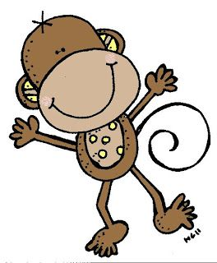
Module 2, Lesson 3
We are going to talk about another type of shape today. Look at this shape. Use your math words to tell about it.
rectangle

Slide 93
Module 2, Lesson 3
Tell about this shape.
rectangle
rectangle

Slide 94
Module 2, Lesson 3
Hmmm…
I wonder if we will have another pattern today.
rectangle

Slide 95
Module 2, Lesson 3
How about this shape? Is it a rectangle, too?
This special rectangle, in which all of the sides are the same length, is called a …?
square
rectangle
rectangle

Slide 96
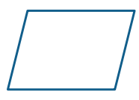
Module 2, Lesson 3
How about this one? Is this a rectangle? It has straight sides and four corners.
NOT a rectangle
rectangle
square

Slide 97
Module 2, Lesson 3
How about this shape?
rectangle
rectangle
square

Slide 98
Module 2, Lesson 3
How about this shape?
NOT a rectangle
rectangle
square

Slide 99
Module 2, Lesson 3
How about this shape?
square
rectangle
square

Slide 100
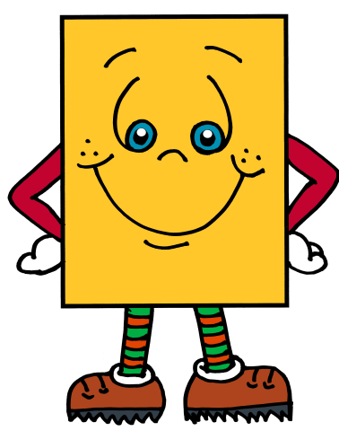
Module 2, Lesson 3
You have learned many rules about rectangles today! Now, make some rectangles of your own. Use the Wikki Stix for the sides, and use the special dots on this paper to keep your sides straight.

Slide 103
Debrief

Slide 104
Lesson 4
I can identify shapes as hexagons and circles.

Slide 105
Module 2, Lesson 4
Fluency
Rectangle or Not?
I’ll show you a shape. We’ll try to decide if it’s a rectangle or not. If you think it’s a rectangle, give me a thumbs-up. If it’s not a rectangle, thumbs-down. Either way, be ready to explain your choice. Here we go!

Slide 106
Module 2, Lesson 4
Fluency
Rectangle or Not?
I’ll show you a shape. We’ll try to decide if it’s a rectangle or not. If you think it’s a rectangle, give me a thumbs-up. If it’s not a rectangle, thumbs-down. Either way, be ready to explain your choice. Here we go!

Slide 107
Module 2, Lesson 4
Fluency
Rectangle or Not?
I’ll show you a shape. We’ll try to decide if it’s a rectangle or not. If you think it’s a rectangle, give me a thumbs-up. If it’s not a rectangle, thumbs-down. Either way, be ready to explain your choice. Here we go!

Slide 108
Module 2, Lesson 4
Fluency
Rectangle or Not?
I’ll show you a shape. We’ll try to decide if it’s a rectangle or not. If you think it’s a rectangle, give me a thumbs-up. If it’s not a rectangle, thumbs-down. Either way, be ready to explain your choice. Here we go!

Slide 109
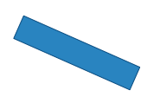
Module 2, Lesson 4
Fluency
Rectangle or Not?
I’ll show you a shape. We’ll try to decide if it’s a rectangle or not. If you think it’s a rectangle, give me a thumbs-up. If it’s not a rectangle, thumbs-down. Either way, be ready to explain your choice. Here we go!

Slide 110
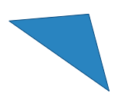
Module 2, Lesson 4
Fluency
Rectangle or Not?
I’ll show you a shape. We’ll try to decide if it’s a rectangle or not. If you think it’s a rectangle, give me a thumbs-up. If it’s not a rectangle, thumbs-down. Either way, be ready to explain your choice. Here we go!

Slide 111
Module 2, Lesson 4
Fluency
Rectangle or Not?
I’ll show you a shape. We’ll try to decide if it’s a rectangle or not. If you think it’s a rectangle, give me a thumbs-up. If it’s not a rectangle, thumbs-down. Either way, be ready to explain your choice. Here we go!

Slide 112
Module 2, Lesson 4
Fluency
Rectangle or Not?
I’ll show you a shape. We’ll try to decide if it’s a rectangle or not. If you think it’s a rectangle, give me a thumbs-up. If it’s not a rectangle, thumbs-down. Either way, be ready to explain your choice. Here we go!

Slide 113
Module 2, Lesson 4
Fluency
Rectangle or Not?
I’ll show you a shape. We’ll try to decide if it’s a rectangle or not. If you think it’s a rectangle, give me a thumbs-up. If it’s not a rectangle, thumbs-down. Either way, be ready to explain your choice. Here we go!

Slide 114
Module 2, Lesson 4
Fluency
Rectangle or Not?
I’ll show you a shape. We’ll try to decide if it’s a rectangle or not. If you think it’s a rectangle, give me a thumbs-up. If it’s not a rectangle, thumbs-down. Either way, be ready to explain your choice. Here we go!

Slide 115
Module 2, Lesson 4
Fluency
Rectangle or Not?
I’ll show you a shape. We’ll try to decide if it’s a rectangle or not. If you think it’s a rectangle, give me a thumbs-up. If it’s not a rectangle, thumbs-down. Either way, be ready to explain your choice. Here we go!

Slide 116
Module 2, Lesson 4
Fluency
Make a Shape
Let’s play Make a Shape. Put 3 of the longer craft sticks on your mat. Move the sticks so they make a shape with 3 points. Touch and count the points. Touch and count the sides. Are there any curved sides?

Slide 117
Module 2, Lesson 4
Fluency
Make a Shape
Trade in your three long sticks for three short ones, and put them on your mat. Move the sticks so they make a new shape with three points. Does your shape still have three points? Three sides? No curved sides?

Slide 118
Module 2, Lesson 4
Fluency
Make a Shape
Now, put one of your sticks back and get one of the longer ones to put on your mat. Move the sticks so they make a new shape with three points. Does your shape still have three points? Three sides? No curved sides?

Slide 119
Module 2, Lesson 4
Fluency
Make a Shape
Now, take two long sticks and one short stick. Make a shape with three points. Does the shape still have three points? Three sides? No curved sides?

Slide 120
Module 2, Lesson 4
Fluency
Make a Shape
Now, take four long sticks. Make a shape with four points. Touch and count the points. Touch and count the sides. Are there any curved sides?

Slide 121
Module 2, Lesson 4
Fluency
Make a Shape
Now, take four short sticks. Make a shape with four points. Does your shape still have four points? Four sides? No curved sides?

Slide 122
Module 2, Lesson 4
Fluency
Make a Shape
Now, take two long sticks and two short sticks. Make a shape with four points. Does your shape still have four points? Four sides? No curved sides?

Slide 123
Module 2, Lesson 4
Fluency
Make a Shape
Now, take six short sticks. Make a shape with six points. Touch and count the points. Touch and count the sides. Are there any curved sides?

Slide 124
Module 2, Lesson 4
Fluency
Groups of 7
When the music starts, calmly walk around the room, visiting corners of the room until you and your classmates can make a group of 7 – don’t forget to count yourself! How many can be in a group? So if you go to a corner that already has 6 people there, can you stay? What if there are already 7? Remember to check all corners of the room. See if we can all get into groups of 7 before the music stops!

Slide 125
Application Problem
Module 2, Lesson 4
Using only triangles and rectangles, design a rocket ship on your paper. Trade rocket ships with your partner. Count how many triangles and rectangles you see in his picture. Did you use the same number of each shape?

Slide 126
Module 2, Lesson 4
We have talked about triangles, rectangles, and squares, and you have made many of these yourselves. I have some new shapes for you to look at today.
hexagon
Tell about this shape!

Slide 127
Module 2, Lesson 4
How about this shape?
hexagon
hexagon

Slide 128
Module 2, Lesson 4
Do you see a pattern?
hexagon

Slide 129
Module 2, Lesson 4
A hexagon is a closed flat shape with six straight sides.
hexagon

Slide 130
Module 2, Lesson 4
How about this shape?
NOT a hexagon
hexagon

Slide 131
Module 2, Lesson 4
How about this shape?
hexagon
hexagon

Slide 132
Module 2, Lesson 4
How about this shape?
NOT a hexagon
hexagon

Slide 133
Module 2, Lesson 4
Here’s another shape. Tell about it!
circle

Slide 134
Module 2, Lesson 4
How about this shape?
oval

Slide 135
Module 2, Lesson 4
A circle is a flat, closed, curved shape with no straight sides.
circle

Slide 136
Module 2, Lesson 4
How about this shape?
NOT a circle

Slide 137
Module 2, Lesson 4
How about this shape?
NOT a circle

Slide 138
Module 2, Lesson 4
How about this shape?
NOT a circle

Slide 139
Module 2, Lesson 4
We are going to have another detective hunt today! Search for circles and hexagons in the classroom. Draw the ones you find on your paper!

Slide 142
Debrief

Slide 143
Lesson 5
I can communicate positions of shapes using the words above, below, beside, in front of, next to, and behind.

Slide 144
Module 2, Lesson 5
Fluency
Groups of Shapes
Choose a shape and meet me at the rug. Look at your shape. Raise your hand if you know the name of your shape. When I give the signal, whisper the name of your shape to yourself. Ready? Look around the room. Do you see signs with pictures of shapes? Do you see your shape? When I start the music, I want you to calmly walk to the sign that has the same shape as yours. When I point to your group, say the name of your shape.

Slide 145
Module 2, Lesson 5
Fluency
Peek-a-Boo Shapes
I’m going to show you a shape, but only for a second! Use the listen, think, raise your hand, and wait for the snap procedure to name the shape.

Slide 146
Module 2, Lesson 5
Fluency
Peek-a-Boo Shapes
I’m going to show you a shape, but only for a second! Use the listen, think, raise your hand, and wait for the snap procedure to name the shape.

Slide 147
Module 2, Lesson 5
Fluency
Peek-a-Boo Shapes
I’m going to show you a shape, but only for a second! Use the listen, think, raise your hand, and wait for the snap procedure to name the shape.

Slide 148
Module 2, Lesson 5
Fluency
Peek-a-Boo Shapes
I’m going to show you a shape, but only for a second! Use the listen, think, raise your hand, and wait for the snap procedure to name the shape.

Slide 149
Module 2, Lesson 5
Fluency
Peek-a-Boo Shapes
I’m going to show you a shape, but only for a second! Use the listen, think, raise your hand, and wait for the snap procedure to name the shape.

Slide 150
Module 2, Lesson 5
Fluency
Peek-a-Boo Shapes
I’m going to show you a shape, but only for a second! Use the listen, think, raise your hand, and wait for the snap procedure to name the shape.

Slide 151
Module 2, Lesson 5
Fluency
Peek-a-Boo Shapes
I’m going to show you a shape, but only for a second! Use the listen, think, raise your hand, and wait for the snap procedure to name the shape.

Slide 152
Module 2, Lesson 5
Fluency
Peek-a-Boo Shapes
I’m going to show you a shape, but only for a second! Use the listen, think, raise your hand, and wait for the snap procedure to name the shape.

Slide 153
Module 2, Lesson 5
Fluency
Peek-a-Boo Shapes
I’m going to show you a shape, but only for a second! Use the listen, think, raise your hand, and wait for the snap procedure to name the shape.

Slide 154
Module 2, Lesson 5
Fluency
Peek-a-Boo Shapes
I’m going to show you a shape, but only for a second! Use the listen, think, raise your hand, and wait for the snap procedure to name the shape.

Slide 155
Module 2, Lesson 5
Fluency
Peek-a-Boo Shapes
I’m going to show you a shape, but only for a second! Use the listen, think, raise your hand, and wait for the snap procedure to name the shape.

Slide 156
Module 2, Lesson 5
Fluency
Peek-a-Boo Shapes
I’m going to show you a shape, but only for a second! Use the listen, think, raise your hand, and wait for the snap procedure to name the shape.

Slide 157
Module 2, Lesson 5
Fluency
Peek-a-Boo Shapes
I’m going to show you a shape, but only for a second! Use the listen, think, raise your hand, and wait for the snap procedure to name the shape.

Slide 158
Module 2, Lesson 5
Fluency
Peek-a-Boo Shapes
I’m going to show you a shape, but only for a second! Use the listen, think, raise your hand, and wait for the snap procedure to name the shape.

Slide 159
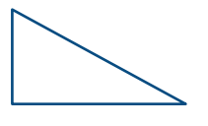
Module 2, Lesson 5
Fluency
Peek-a-Boo Shapes
I’m going to show you a shape, but only for a second! Use the listen, think, raise your hand, and wait for the snap procedure to name the shape.

Slide 160
Module 2, Lesson 5
Fluency
Peek-a-Boo Shapes
I’m going to show you a shape, but only for a second! Use the listen, think, raise your hand, and wait for the snap procedure to name the shape.

Slide 161
Module 2, Lesson 5
Fluency
Peek-a-Boo Shapes
I’m going to show you a shape, but only for a second! Use the listen, think, raise your hand, and wait for the snap procedure to name the shape.

Slide 162
Module 2, Lesson 5
Fluency
Peek-a-Boo Shapes
I’m going to show you a shape, but only for a second! Use the listen, think, raise your hand, and wait for the snap procedure to name the shape.

Slide 163
Module 2, Lesson 5
Fluency
Peek-a-Boo Shapes
I’m going to show you a shape, but only for a second! Use the listen, think, raise your hand, and wait for the snap procedure to name the shape.

Slide 164
Module 2, Lesson 5
Fluency
Peek-a-Boo Shapes
I’m going to show you a shape, but only for a second! Use the listen, think, raise your hand, and wait for the snap procedure to name the shape.

Slide 165
Module 2, Lesson 5
Fluency
Peek-a-Boo Shapes
I’m going to show you a shape, but only for a second! Use the listen, think, raise your hand, and wait for the snap procedure to name the shape.

Slide 166
Module 2, Lesson 5
Fluency
Peek-a-Boo Shapes
I’m going to show you a shape, but only for a second! Use the listen, think, raise your hand, and wait for the snap procedure to name the shape.

Slide 167
Module 2, Lesson 5
Fluency
Groups of 8
When the music starts, calmly walk around the room, visiting corners of the room until you and your classmates can make a group of 8 – don’t forget to count yourself! How many can be in a group? So if you go to a corner that already has 7 people there, can you stay? What if there are already 8? Remember to check all corners of the room. See if we can all get into groups of 8 before the music stops!

Slide 168
Application Problem
Module 2, Lesson 5
Work with your partner. Stand somewhere in the classroom so that you are facing a wall, but your partner is facing the other way. Tell your partner several things that you think are behind you in the room. Have him look to see if you are right. When you are done, switch places with your partner.

Slide 169
Module 2, Lesson 5
You have a new mystery bag! Carefully shake your shapes onto your desk. Work with your partner, and say the name of each shape.

Slide 170
Let’s play Simon Says!
Module 2, Lesson 5
I will describe a shape to you. If I say, “Simon Says!” find the shape, hold it up, and freeze.
Simon says hold up a shape that has three corners and three sides.
Hold up a shape that has six sides that are exactly the same.
Hold up a shape that has four sides that are exactly the same.
Simon says hold up a shape that has four corners.
Simon says hold up a shape that has no straight sides.
Simon says hold up a shape that has one more than five sides.
Simon
Says!

Slide 171
Module 2, Lesson 5
Now, put all of your shapes in a row on top of your desk. We are going to play our game in a different way. I am going to ask you to arrange your shapes in certain ways. Listen carefully, and don’t forget to listen for “Simon Says!”

Slide 172
Module 2, Lesson 5
Simon says put a shape with one less than four sides in the middle of your desk.

Slide 173
Module 2, Lesson 5
Simon says put a shape made with a curved line beside that shape.

Slide 174
Module 2, Lesson 5
Simon says put a shape with only one L-corner next to the shape with a curved line.

Slide 175
Module 2, Lesson 5
Put a shape with six corners next to that shape.

Slide 176
Now, listen to these directions!
Module 2, Lesson 5
Simon says put a curved shape below your chair.

Slide 177
Module 2, Lesson 5
Simon says hold your square above your head.

Slide 178
Module 2, Lesson 5
Simon says hold it behind your friend.

Slide 179
Module 2, Lesson 5
Put a square in front of you.

Slide 182
Debrief

Slide 183
Lesson 6
I can find and describe solid shapes.

Slide 184
Module 2, Lesson 6
Fluency
Beep Number
Listen carefully while I count. Instead of saying a number, I’ll say beep. When you know what the beep number is, raise your hand.
5, beep, 7

Slide 185
Module 2, Lesson 6
Fluency
Beep Number
Listen carefully while I count. Instead of saying a number, I’ll say beep. When you know what the beep number is, raise your hand.
7, beep, 5

Slide 186
Module 2, Lesson 6
Fluency
Beep Number
Listen carefully while I count. Instead of saying a number, I’ll say beep. When you know what the beep number is, raise your hand.
6, 7, beep

Slide 187
Module 2, Lesson 6
Fluency
Beep Number
Listen carefully while I count. Instead of saying a number, I’ll say beep. When you know what the beep number is, raise your hand.
beep, 7, 6

Slide 188
Module 2, Lesson 6
Fluency
Beep Number
Listen carefully while I count. Instead of saying a number, I’ll say beep. When you know what the beep number is, raise your hand.
7, 8, beep, 10

Slide 189
Module 2, Lesson 6
Fluency
Beep Number
Listen carefully while I count. Instead of saying a number, I’ll say beep. When you know what the beep number is, raise your hand.
9, 8, beep, 6

Slide 190
Module 2, Lesson 6
Fluency
Beep Number
Listen carefully while I count. Instead of saying a number, I’ll say beep. When you know what the beep number is, raise your hand.
4, beep, 6, 7

Slide 191
Module 2, Lesson 6
Fluency
Beep Number
Listen carefully while I count. Instead of saying a number, I’ll say beep. When you know what the beep number is, raise your hand.
7, 6, 5, beep

Slide 192
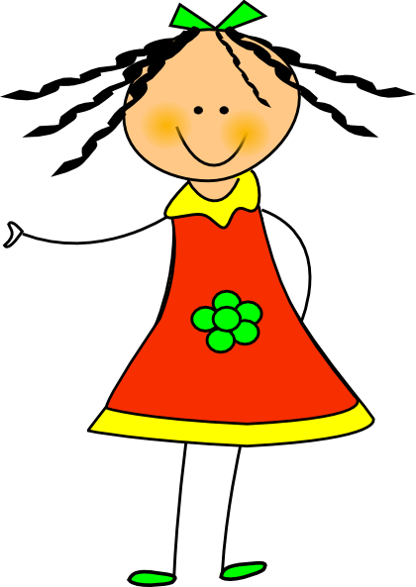
Module 2, Lesson 6
Fluency
Hide and See
Touch and count your cubes. Hide 2 behind your back. How many can you see? Write the expression on your board.

Slide 193
Module 2, Lesson 6
Fluency
Hide and See
Put them back together. How many cubes do you have?

Slide 194
Module 2, Lesson 6
Fluency
Hide and See
Touch and count your cubes. Hide 1 behind your back. How many can you see? Write the expression on your board.

Slide 195
Module 2, Lesson 6
Fluency
Hide and See
Put them back together. How many cubes do you have?

Slide 196
Module 2, Lesson 6
Fluency
Hide and See
Touch and count your cubes. Hide 3 behind your back. How many can you see? Write the expression on your board.

Slide 197
Module 2, Lesson 6
Fluency
Hide and See
Put them back together. How many cubes do you have?

Slide 198
Module 2, Lesson 6
Fluency
Hide and See
Touch and count your cubes. Hide 4 behind your back. How many can you see? Write the expression on your board.

Slide 199
Module 2, Lesson 6
Fluency
Hide and See
Put them back together. How many cubes do you have?

Slide 200
Module 2, Lesson 6
Fluency
Hide and See
Touch and count your cubes. Hide 5 behind your back. How many can you see? Write the expression on your board.

Slide 201
Module 2, Lesson 6
Fluency
Hide and See
Put them back together. How many cubes do you have?

Slide 202
Module 2, Lesson 6
Fluency
Take Apart Groups of Circles
Draw three circles on your board. Put an X on two of them. How many circles have an X? How many circles do not have an X. How many circles are on your board? Raise your hand when you can say the number sentence starting with 2.

Slide 203
Module 2, Lesson 6
Fluency
Take Apart Groups of Circles
Erase. Draw 4 circles on your board. Put an X on three of them. How many do not have an X? Raise your hand when you can say the number sentence starting with 3.

Slide 204
Module 2, Lesson 6
Fluency
Take Apart Groups of Circles
Erase. Draw 5 circles on your board. Put an X on two of them. How many do not have an X? Raise your hand when you can say the number sentence starting with 2.

Slide 205
Module 2, Lesson 6
Fluency
Take Apart Groups of Circles
Erase. Draw 4 circles on your board. Put an X on one of them. How many do not have an X? Raise your hand when you can say the number sentence starting with 1.

Slide 206
Module 2, Lesson 6
Fluency
Take Apart Groups of Circles
Erase. Draw 5 circles on your board. Put an X on four of them. How many do not have an X? Raise your hand when you can say the number sentence starting with 4.

Slide 207
Application Problem
Module 2, Lesson 6
We are going to do a test. Take turns with your partner. Roll the ball back and forth between you a few times. Watch the ball carefully as it rolls. Now, try to roll the block between you. Talk to you partner about what happens. Why do you think the objects behave so differently. What would be the best way to get the block to your partner? Why don’t cubes that have a circle on the bottom roll off the table?

Slide 208
Module 2, Lesson 6
I have something new for you to explore today! You will be working with your partner. Please take everything out of your bag. I will give you a few minutes to look and talk with your partner about what you notice.

Slide 209
Module 2, Lesson 6
Place your things on your desk. Stand up and look down at them as though you were a bird. What do you notice?

Slide 210
Module 2, Lesson 6
Now, pretend that you are an ant. Bend down and look from eye level across the top of your desk. When you did this with your flat shapes, you said you couldn’t see them anymore. What happens this time?
We call these solids!

Slide 211
Module 2, Lesson 6
Look at this sold. Find the one that looks like it on your desk. How is it different?

Slide 212
Module 2, Lesson 6
Look at this sold. Find the one that looks like it on your desk. How is it different?

Slide 213
Module 2, Lesson 6
Look at this sold. Find the one that looks like it on your desk. How is it different?

Slide 214
Module 2, Lesson 6
Look at this sold. Find the one that looks like it on your desk. How is it different?

Slide 215
Module 2, Lesson 6
It’s time to go on a detective hunt! Put your shapes back in the bag, and get out your detective materials. You and your partner are going to look for these shapes around the room. When you find one, draw it on your paper.

Slide 217
Debrief

Slide 218
Lesson 7
I can classify and name solid shapes.

Slide 219
Module 2, Lesson 7
Fluency
Show Me Shapes
Look at the shapes that are on the rug. I will ask you to find a certain kind of shape. When you find it, hold it up. Ready?
Show me shapes that have points.

Slide 220
Module 2, Lesson 7
Fluency
Show Me Shapes
Look at the shapes that are on the rug. I will ask you to find a certain kind of shape. When you find it, hold it up. Ready?
Show me shapes that have no points.

Slide 221
Module 2, Lesson 7
Fluency
Show Me Shapes
Look at the shapes that are on the rug. I will ask you to find a certain kind of shape. When you find it, hold it up. Ready?
Show me shapes that have a curve.

Slide 222
Module 2, Lesson 7
Fluency
Show Me Shapes
Look at the shapes that are on the rug. I will ask you to find a certain kind of shape. When you find it, hold it up. Ready?
Now, work with your partner and test each other!

Slide 223
Module 2, Lesson 7
Fluency
Making 5 with 5-Group Mats
Turn your 5-group mat up and down like mine. Now, it is vertical. Touch and count your cubes. Touch and count the dots on your mat. Our job is to make 5. Put 4 cubes on the dots of your mat. Raise your hand when know how many more cubes to make 5.

Slide 224
Module 2, Lesson 7
Fluency
Making 5 with 5-Group Mats
We can tell how to make 5 like this: 4 and 1 make 5.
Echo me, please.

Slide 225
Module 2, Lesson 7
Fluency
Making 5 with 5-Group Mats
Put 3 cubes on the dots of your mat. Raise your hand when you know how many more cubes to make 5. Tell me the number sentence.

Slide 226
Module 2, Lesson 7
Fluency
Making 5 with 5-Group Mats
Put 2 cubes on the dots of your mat. Raise your hand when you know how many more cubes to make 5. Tell me the number sentence.

Slide 227
Module 2, Lesson 7
Fluency
Making 5 with 5-Group Mats
Put 1 cube on the dots of your mat. Raise your hand when you know how many more cubes to make 5. Tell me the number sentence.

Slide 228
Module 2, Lesson 7
Fluency
5-Group Hands
Raise your hand when you know how many dots are on top. Bottom?

Slide 229
Module 2, Lesson 7
Fluency
5-Group Hands
We can show this 5-group on our hands. Five on top, 1 on the bottom, like this.

Slide 230
Module 2, Lesson 7
Fluency
5-Group Hands
Push your hands out as you count on from 5, like this. (Click) Try it with me!
Five…
Six

Slide 231
Module 2, Lesson 7
Fluency
5-Group Hands
Raise your hand when you know how many dots are on top. Bottom? Show this 5-group with your hands and then count on.

Slide 232
Module 2, Lesson 7
Fluency
5-Group Hands
Raise your hand when you know how many dots are on top. Bottom? Show this 5-group with your hands and then count on.

Slide 233
Module 2, Lesson 7
Fluency
5-Group Hands
Raise your hand when you know how many dots are on top. Bottom? Show this 5-group with your hands and then count on.

Slide 234
Module 2, Lesson 7
Fluency
5-Group Hands
Raise your hand when you know how many dots are on top. Bottom? Show this 5-group with your hands and then count on.

Slide 235
Module 2, Lesson 7
Fluency
5-Group Hands
Raise your hand when you know how many dots are on top. Bottom? Show this 5-group with your hands and then count on.

Slide 236
Module 2, Lesson 7
Fluency
5-Group Hands
Raise your hand when you know how many dots are on top. Bottom? Show this 5-group with your hands and then count on.

Slide 237
Application Problem
Module 2, Lesson 7
Think about the solids you investigated yesterday. Now, listen to the riddle, and make this mystery solid with your clay:
I am a solid that can roll. I don’t have any corners. I have zero edges. Make me!
Show your solid to a friend. Do your solids look alike?

Slide 238
Module 2, Lesson 7
Take your solids out of your bag. We are going to look at them carefully to see if any of them have things in common. If they do, we can sort them. Does anyone have any ideas?

Slide 239
Module 2, Lesson 7
This solid is called a cone.
What do you notice about this solid?
The circle, the flat part of the cone, is called a face. Take a smiley sticker and put it on the face of your cone.

Slide 240
Module 2, Lesson 7
Do you have other solids that have faces?
Why can’t you see all my stickers?
Yes! The cube has many faces! Put a smiley face sticker on each face of the cube. How many faces?

Slide 241
Module 2, Lesson 7
Do you have other solids that have faces?
Why can’t you see both my stickers?
Yes! The cylinder has faces, too! Put a smiley face sticker on each face of the cube. How many faces?

Slide 242
Module 2, Lesson 7
Can we sort our solids into groups of those with a face and those without?
FACE | NO FACE
Go in this order: cube, cone, sphere, cylinder.

Slide 243
Module 2, Lesson 7
Now, let’s sort them into groups of those that roll and those that only slide!
ROLLS | ONLY SLIDES
Go in this order: cube, cone, sphere, cylinder.

Slide 244
Module 2, Lesson 7
Now, let’s sort them into groups of those that can stack and those that cannot.
CAN STACK | CANNOT STACK
Go in this order: cube, cone, sphere, cylinder.

Slide 245
Module 2, Lesson 7
Now, let’s sort them into groups of those that have corners and those that don’t.
CORNERS | NO CORNERS
Go in this order: cube, cone, sphere, cylinder.

Slide 246
Module 2, Lesson 7
Now, let’s sort them into groups of those that have edges and those that don’t.
CORNERS | NO CORNERS
Go in this order: cube, cone, sphere, cylinder.

Slide 247
Module 2, Lesson 7
Which of your solids has the most faces?
The cube!
Put your cube on one of its faces onto your piece of paper. Use your favorite colored pencil to trace around the solid. Lift your solid. What do you see?

Slide 248
Module 2, Lesson 7
What would happen if you traced the face of your cone?

Slide 249
Module 2, Lesson 7
Should we trace a face of the cylinder?

Slide 250
Module 2, Lesson 7
Trace the faces of any of your objects to make shape designs on your paper!

Slide 252
Debrief

Slide 253
Lesson 8
I can describe and communicate the positions of solid shapes using the words above, below, beside, in front of, next to, and behind.

Slide 254
Module 2, Lesson 8
Fluency
Position Word Game
Work with your partner. I will give you directions for activities to do with your partner.
Partner A, put your hand above Partner B’s head.

Slide 255
Module 2, Lesson 8
Fluency
Position Word Game
Work with your partner. I will give you directions for activities to do with your partner.
Stand beside your partner.

Slide 256
Module 2, Lesson 8
Fluency
Position Word Game
Work with your partner. I will give you directions for activities to do with your partner.
Partner B, stand in front of Partner A.

Slide 257
Module 2, Lesson 8
Fluency
Position Word Game
Work with your partner. I will give you directions for activities to do with your partner.
Partner A, put your hand below Partner B’s hand.

Slide 258
Module 2, Lesson 8
Fluency
Position Word Game
Work with your partner. I will give you directions for activities to do with your partner.
Partner B, put your right foot next to Partner A’s left foot.

Slide 259
Module 2, Lesson 8
Fluency
Position Word Game
Work with your partner. I will give you directions for activities to do with your partner.
Partner A, sit behind Partner B.

Slide 260
Module 2, Lesson 8
Fluency
Show Me Shapes
Look at the solid shapes that are on the rug. I will ask you to find a certain kind of shape. When you find it, hold it up and say it’s name on my signal. Ready?
Show me shapes that have points.

Slide 261
Module 2, Lesson 8
Fluency
Show Me Shapes
Look at the solid shapes that are on the rug. I will ask you to find a certain kind of shape. When you find it, hold it up and say it’s name on my signal. Ready?
Show me shapes that have no points.

Slide 262
Module 2, Lesson 8
Fluency
Show Me Shapes
Look at the solid shapes that are on the rug. I will ask you to find a certain kind of shape. When you find it, hold it up and say it’s name on my signal. Ready?
Show me shapes that have a curve.

Slide 263
Module 2, Lesson 8
Fluency
Show Me Shapes
Look at the solid shapes that are on the rug. I will ask you to find a certain kind of shape. When you find it, hold it up and say it’s name on my signal. Ready?
Now, work with your partner and test each other!

Slide 264
Module 2, Lesson 8
Fluency
Rekenrek Roller Coaster
Gradually raise your hand as the numbers increase and lower your hand as the numbers decrease, like the motion of a wave.

Slide 265
Module 2, Lesson 8
Fluency
Rekenrek Roller Coaster
Gradually raise your hand as the numbers increase and lower your hand as the numbers decrease, like the motion of a wave.

Slide 266
Module 2, Lesson 8
Fluency
Rekenrek Roller Coaster
Gradually raise your hand as the numbers increase and lower your hand as the numbers decrease, like the motion of a wave.

Slide 267
Module 2, Lesson 8
Fluency
Rekenrek Roller Coaster
Gradually raise your hand as the numbers increase and lower your hand as the numbers decrease, like the motion of a wave.

Slide 268
Module 2, Lesson 8
Fluency
Rekenrek Roller Coaster
Gradually raise your hand as the numbers increase and lower your hand as the numbers decrease, like the motion of a wave.

Slide 269
Module 2, Lesson 8
Fluency
Rekenrek Roller Coaster
Gradually raise your hand as the numbers increase and lower your hand as the numbers decrease, like the motion of a wave.

Slide 270
Module 2, Lesson 8
Fluency
Rekenrek Roller Coaster
Gradually raise your hand as the numbers increase and lower your hand as the numbers decrease, like the motion of a wave.

Slide 271
Module 2, Lesson 8
Fluency
Rekenrek Roller Coaster
Gradually raise your hand as the numbers increase and lower your hand as the numbers decrease, like the motion of a wave.

Slide 272
Module 2, Lesson 8
Fluency
Rekenrek Roller Coaster
Gradually raise your hand as the numbers increase and lower your hand as the numbers decrease, like the motion of a wave.

Slide 273
Module 2, Lesson 8
Fluency
Rekenrek Roller Coaster
Gradually raise your hand as the numbers increase and lower your hand as the numbers decrease, like the motion of a wave.

Slide 274
Module 2, Lesson 8
Fluency
Rekenrek Roller Coaster
Gradually raise your hand as the numbers increase and lower your hand as the numbers decrease, like the motion of a wave.

Slide 275
Module 2, Lesson 8
Fluency
Rekenrek Roller Coaster
Gradually raise your hand as the numbers increase and lower your hand as the numbers decrease, like the motion of a wave.

Slide 276
Module 2, Lesson 8
Fluency
Rekenrek Roller Coaster
Gradually raise your hand as the numbers increase and lower your hand as the numbers decrease, like the motion of a wave.

Slide 277
Module 2, Lesson 8
Fluency
Rekenrek Roller Coaster
Gradually raise your hand as the numbers increase and lower your hand as the numbers decrease, like the motion of a wave.

Slide 278
Module 2, Lesson 8
Fluency
Rekenrek Roller Coaster
Gradually raise your hand as the numbers increase and lower your hand as the numbers decrease, like the motion of a wave.

Slide 279
Module 2, Lesson 8
Fluency
Rekenrek Roller Coaster
Gradually raise your hand as the numbers increase and lower your hand as the numbers decrease, like the motion of a wave.

Slide 280
Module 2, Lesson 8
Fluency
Rekenrek Roller Coaster
Gradually raise your hand as the numbers increase and lower your hand as the numbers decrease, like the motion of a wave.

Slide 281
Module 2, Lesson 8
Fluency
Rekenrek Roller Coaster
Gradually raise your hand as the numbers increase and lower your hand as the numbers decrease, like the motion of a wave.

Slide 282
Module 2, Lesson 8
Fluency
Rekenrek Roller Coaster
Gradually raise your hand as the numbers increase and lower your hand as the numbers decrease, like the motion of a wave.

Slide 283
Module 2, Lesson 8
Fluency
Rekenrek Roller Coaster
Gradually raise your hand as the numbers increase and lower your hand as the numbers decrease, like the motion of a wave.

Slide 284
Module 2, Lesson 8
Fluency
Rekenrek Roller Coaster
Gradually raise your hand as the numbers increase and lower your hand as the numbers decrease, like the motion of a wave.

Slide 285
Module 2, Lesson 8
Fluency
Rekenrek Roller Coaster
Gradually raise your hand as the numbers increase and lower your hand as the numbers decrease, like the motion of a wave.

Slide 286
Module 2, Lesson 8
Fluency
Rekenrek Roller Coaster
Gradually raise your hand as the numbers increase and lower your hand as the numbers decrease, like the motion of a wave.

Slide 287
Module 2, Lesson 8
Fluency
Rekenrek Roller Coaster
Gradually raise your hand as the numbers increase and lower your hand as the numbers decrease, like the motion of a wave.

Slide 288
Module 2, Lesson 8
Fluency
Rekenrek Roller Coaster
Gradually raise your hand as the numbers increase and lower your hand as the numbers decrease, like the motion of a wave.

Slide 289
Module 2, Lesson 8
Fluency
Rekenrek Roller Coaster
Gradually raise your hand as the numbers increase and lower your hand as the numbers decrease, like the motion of a wave.

Slide 290
Application Problem
Module 2, Lesson 8
Make a sphere with your ball of clay. Make your ball into a cylinder. Make your cylinder into a cube. Make your cube into a cone. Put your cone next to your partner’s. Partner A, put your cone above Partner B’s.

Slide 291
Module 2, Lesson 8
Let’s play Guess What I Am!
I have two bags in front of me. Who can guess what is in my bags? I need a volunteer to come put his hand in my first bag and find one of the objects. Don’t look at it! See if you can guess by just feeling it. Tell us about it. What is it?
Find those objects in your bag and put them on your desks.

Slide 292
Module 2, Lesson 8
I need another volunteer to feel something in my bag. Tell us about it. What is it?
Now, I want my volunteer to take a card out of the other bag. Find a cube in your bag and follow the directions on the card to place it with your first object.
Let’s keep playing!

Slide 293
Module 2, Lesson 8
Now, arrange the solids on your desk. You will play a similar game with your partner, but in a different way. Tell your partner a riddle like, “I am the solid that is next to the cube. What am I?” When your partner guesses the solid correctly, it will be his turn to give you a riddle.

Slide 294
Cut out your shapes and listen carefully to the directions I give you.

Slide 296
Debrief

Slide 297
Lesson 9
I can identify and sort shapes as two-dimensional and three-dimensional.

Slide 298
Module 2, Lesson 9
Fluency
Groups of Shapes
Choose a shape and meet me at the rug. Look at your shape. Raise your hand if you know the name of your shape. When I give the signal, whisper the name of your shape to yourself. Ready? Look around the room. Do you see signs with pictures of shapes? Do you see your shape? When I start the music, I want you to calmly walk to the sign that has the same shape as yours. When I point to your group, say the name of your shape.

Slide 299
Module 2, Lesson 9
Fluency
Groups of 9
When the music starts, calmly walk around the room, visiting corners of the room until you and your classmates can make a group of 9 – don’t forget to count yourself! How many can be in a group? So if you go to a corner that already has 8 people there, can you stay? What if there are already 9? Remember to check all corners of the room. See if we can all get into groups of 9 before the music stops!

Slide 300
Module 2, Lesson 9
Fluency
Hide and See
Touch and count your cubes. Hide 2 behind your back. How many can you see? Write the expression on your board.

Slide 301
Module 2, Lesson 9
Fluency
Hide and See
Put them back together. How many cubes do you have?

Slide 302
Module 2, Lesson 9
Fluency
Hide and See
Touch and count your cubes. Hide 1 behind your back. How many can you see? Write the expression on your board.

Slide 303
Module 2, Lesson 9
Fluency
Hide and See
Put them back together. How many cubes do you have?

Slide 304
Module 2, Lesson 9
Fluency
Hide and See
Touch and count your cubes. Hide 3 behind your back. How many can you see? Write the expression on your board.

Slide 305
Module 2, Lesson 9
Fluency
Hide and See
Put them back together. How many cubes do you have?

Slide 306
Module 2, Lesson 9
Fluency
Hide and See
Touch and count your cubes. Hide 4 behind your back. How many can you see? Write the expression on your board.

Slide 307
Module 2, Lesson 9
Fluency
Hide and See
Put them back together. How many cubes do you have?

Slide 308
Module 2, Lesson 9
Fluency
Hide and See
Touch and count your cubes. Hide 5 behind your back. How many can you see? Write the expression on your board.

Slide 309
Module 2, Lesson 9
Fluency
Hide and See
Put them back together. How many cubes do you have?

Slide 310
Application Problem
Module 2, Lesson 9
Draw one of the shapes that we have talked about this week. Can you make a solid with your clay that has the shape your drew as one of its faces? Share your work with your partner when you are done.

Slide 311
Module 2, Lesson 9
Take out all of your flat shapes and all of your solids, and arrange them in front of you.

Slide 312
Module 2, Lesson 9
Stand up and look at your things as though you were a bird. What do you see?

Slide 313
Module 2, Lesson 9
Now, bend down and look across your desk as though you were an ant. What do you notice?

Slide 314
Module 2, Lesson 9
Do you think we could sort all of the things on your desk? Look at all of your objects and think about what things they might have in common. Does anyone have a sorting rule for us to try? Let’s try some of your ideas!

Slide 315
Module 2, Lesson 9
Listen to my directions. I will say the name of a shape or solid. When I do, echo me, find the object, and put it back in its bag.
sphere
cone
circle
hexagon
square
cylinder
triangle
rectangle
cube

Slide 317
Debrief

Slide 318
Lesson 10
I can create a display of different flat shapes with a corresponding solid shape.

Slide 319
Module 2, Lesson 10
Fluency
Groups of Shapes
Choose a shape and meet me at the rug. Look at your shape. Raise your hand if you know the name of your shape. When I give the signal, whisper the name of your shape to yourself. Ready? Look around the room. Do you see signs with pictures of shapes? Do you see your shape? When I start the music, I want you to calmly walk to the sign that has the same shape as yours. When I point to your group, say the name of your shape.

Slide 320
Module 2, Lesson 10
Fluency
5-Group Hands
Raise your hand when you know how many dots are on top. Bottom?

Slide 321
Module 2, Lesson 10
Fluency
5-Group Hands
We can show this 5-group on our hands. Five on top, 1 on the bottom, like this.

Slide 322
Module 2, Lesson 10
Fluency
5-Group Hands
Push your hands out as you count on from 5, like this. (Click) Try it with me!
Five…
Six

Slide 323
Module 2, Lesson 10
Fluency
5-Group Hands
Raise your hand when you know how many dots are on top. Bottom? Show this 5-group with your hands and say the number sentence.

Slide 324
Module 2, Lesson 10
Fluency
5-Group Hands
Raise your hand when you know how many dots are on top. Bottom? Show this 5-group with your hands and say the number sentence.

Slide 325
Module 2, Lesson 10
Fluency
5-Group Hands
Raise your hand when you know how many dots are on top. Bottom? Show this 5-group with your hands and say the number sentence.

Slide 326
Module 2, Lesson 10
Fluency
5-Group Hands
Raise your hand when you know how many dots are on top. Bottom? Show this 5-group with your hands and say the number sentence.

Slide 327
Module 2, Lesson 10
Fluency
5-Group Hands
Raise your hand when you know how many dots are on top. Bottom? Show this 5-group with your hands and say the number sentence.

Slide 328
Module 2, Lesson 10
Fluency
5-Group Hands
Raise your hand when you know how many dots are on top. Bottom? Show this 5-group with your hands and say the number sentence.

Slide 329
Module 2, Lesson 10
We are going to have a Shape Fair today! I’m going to call you and your partner up to choose a shape from my bag. You will work with your partner to create an exhibit about that shape. You will go to a station and use the materials there to show what you know. You have cutouts, pictures, craft supplies, and drawing materials. What are some of the things you could do to show what you’ve learned about a shape?
There will be a bag of solids at your station as well. Could they help you show your shape?
One last mission: I have a work mat for you to use. On the mat, the left side says, “These are ________.” The other side says, “These are not _______.” You will draw your shape in the blank spaces and then use this mat to do some sorting. Show some things that do and don’t match your shape in order to help you visitors understand the shape better.

Slide 330
Shape
Fair
Module 2, Lesson 10

Slide 331
Debrief

